Slide 1


Greener Pastures
Kevin Sheekey
Kyle Pavelka
Matthew Brown
Meriane Franco
Ravi Patel
03/20/2021

Slide 2

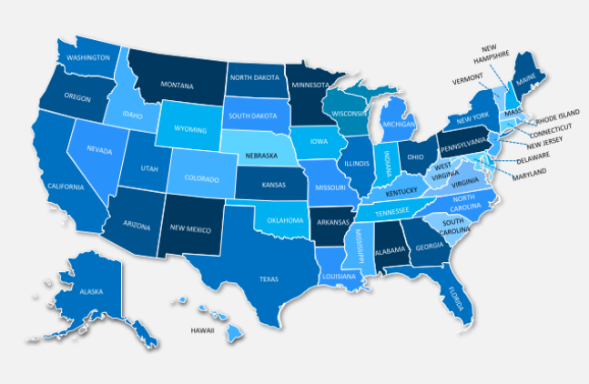
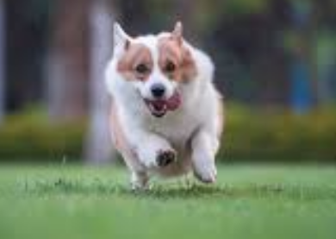


Motivation
Is there a better place to go now?
No matter the current condition people have,
there is always a search for BETTER.

Slide 3
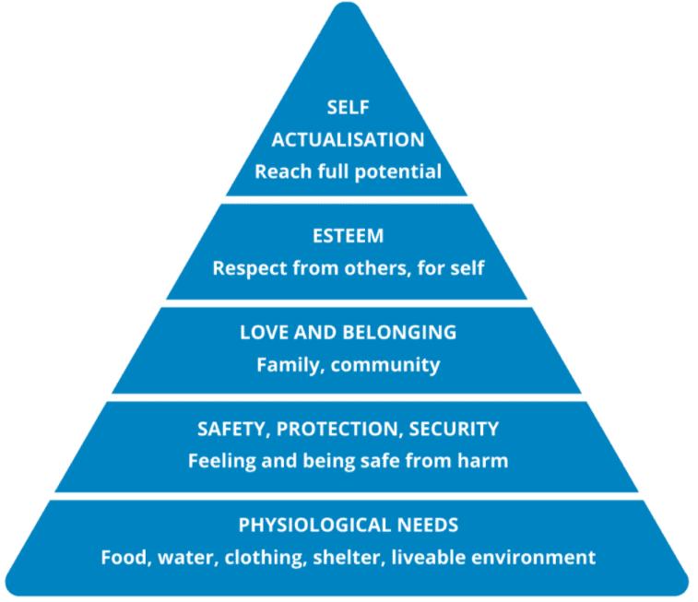
What does BETTER mean?
Economics
Job opportunities
Safety
Health system
Fun & Entertainment
Cost of living
Maslow's Pyramid of Human Needs

Slide 4
Data needed
Economics
Business opening vs closure
Job opportunities
Availability & salaries
Safety
Less crimes incidence
Health system
Availability
Fun & Entertainment
Public & Pet Spaces
Cost of living
Housing cost

Slide 5
Data Source
Crime incidence
https://crime-data-explorer.fr.cloud.gov/api
Economics -Business opening vs closure
EconomicTracker/oi_tracker_data_dictionary.md at main · OpportunityInsights/EconomicTracker · GitHub
Job Availability & salaries
https://www.bls.gov/data/#unemployment
Housing cost
https://www.bestplaces.net/housing/zip-code/new_jersey/edison/08820
Public & Pet Spaces
Health system availability

Slide 6
Slide title xxxxx
KEY TAKE AWAYS
Aa
Bb
Cc

Slide 7
Slide title
KEY TAKE AWAYS
Aa
Bb
Cc

Slide 8
Slide title
KEY TAKE AWAYS
Aa
Bb
Cc

Slide 9


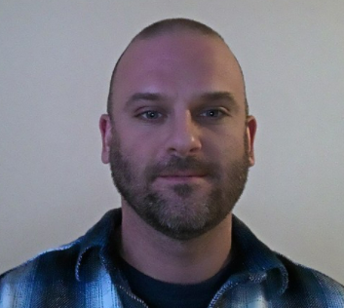
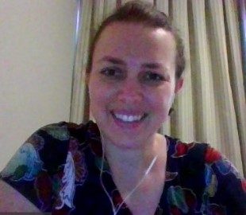
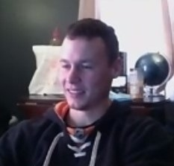
Questions
KYLE PAVELKA
kylepavelka1@gmail.com
RAVI PATEL
rp70960@gmail.com
MATT BROWN
matthewbrown84@gmail.com
MERI FRANCO
francomeriane@gmail.com
KEVIN SHEEKEY
ksheekey27@gmail.com
“Always dream and shoot higher than you know you can do. Don’t bother just to be better than your contemporaries or predecessors. Try to be better than yourself.” —William Faulkner

Slide 10
Support slides (only if needed)
KEY TAKE AWAYS
Aa
Bb
Cc

Slide 11
ALL SLIDES AFTER THIS ONE WILL BE DELETED

Slide 12
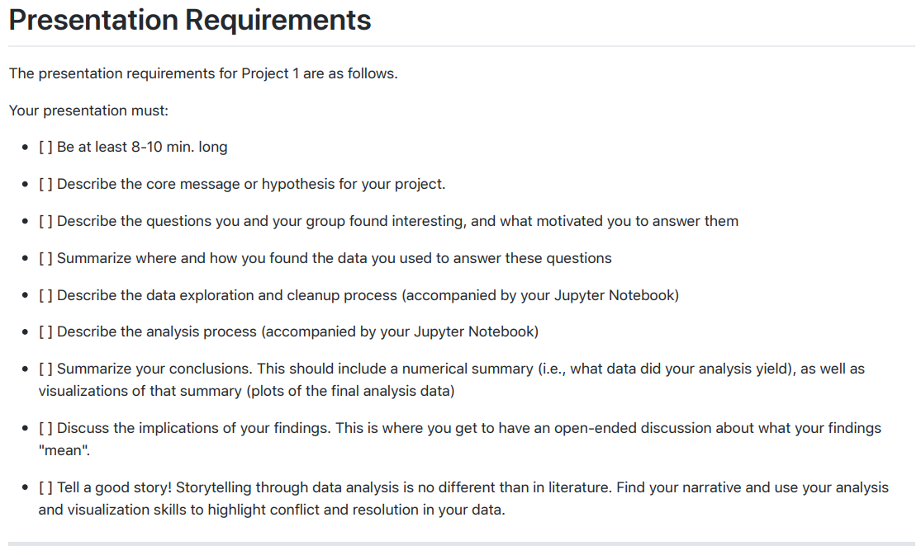

Slide 13
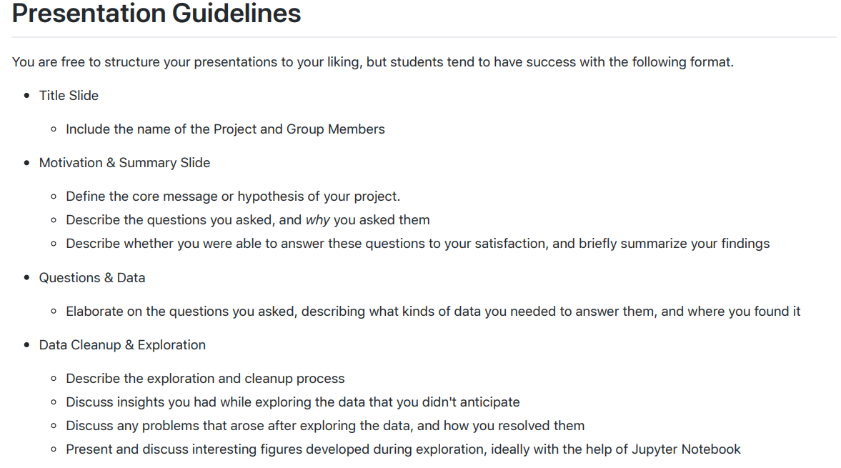

Slide 14
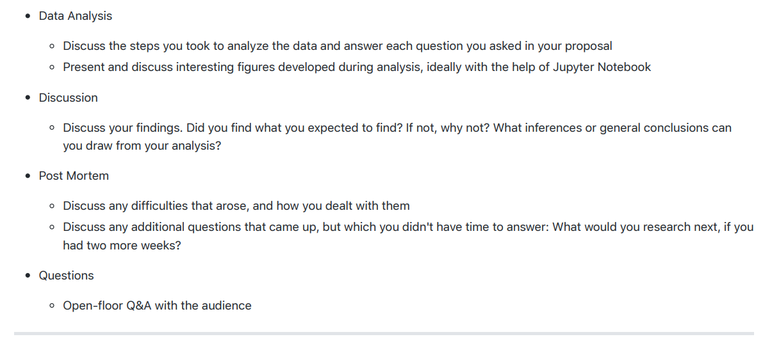

Slide 15
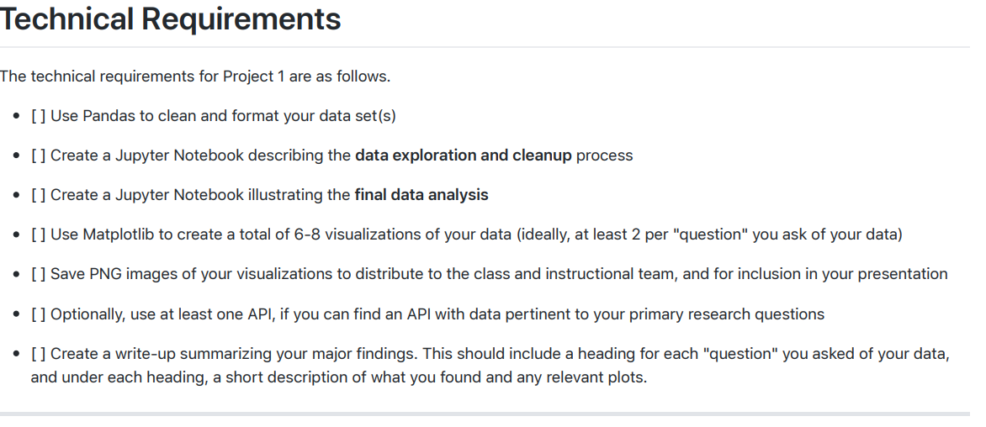

Slide 16
 | MONTHLY ANNIMATION – Business
 | Function to generate heat maps Jobs salaries

